Slide 1
AS/NZS3080
“Applies to the use of generic cabling within commercial premises which may comprise a single buildings or multiple buildings on a campus” (AS/NZS3080:2013).
Designed for organisations distributing telecommunications cabling up to 2000m.
If an installation is performed according to this standard then it should have a useful life of at least 10 years.
Notes:
Has been updated to AS/NZS3080:2013 – mainly changes to fibre.
Purpose of this presentation – to be aware that it exists and be familiar with the terminology.

Slide 2
Functional Elements
The elements that make up the structured cabling system are:
  Campus Distributor (CD)
  Campus Backbone Cabling
  Building Distributor (BD)
  Building Backbone Cabling
  Floor Distributor (FD)
  Horizontal Cable
  Consolidation Point (CP)
  Consolidation Point Cable (CP Cable)
  Telecommunications Outlet (TO)
  Multi-user Telecommunications Outlet (MUTO)
Notes:
Consolidation Point: “A location for interconnection between horizontal cables extending from building pathways and horizontal cables extending into furniture pathways.”

Slide 3
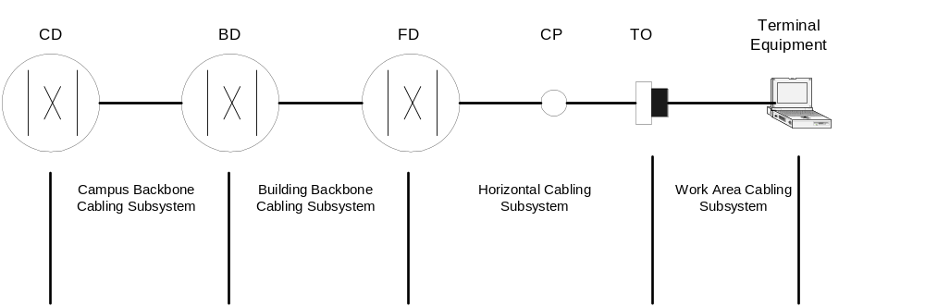
Relationship of Elements
The distributors provide the flexibility to configure various topologies such as star, ring, bus etc
Notes:
TO = floor sockets
CP = hub or switch

Slide 4
Cross Connection Cabinets / Distributors
Distributors allow the network manager to be flexible in the arrangement of the network
At any one time only a fraction of the ports in rooms are in use. A cross connect cabinet allows the network manager to connect the limited “trunk” cables to the ports that have devices attached

Slide 5
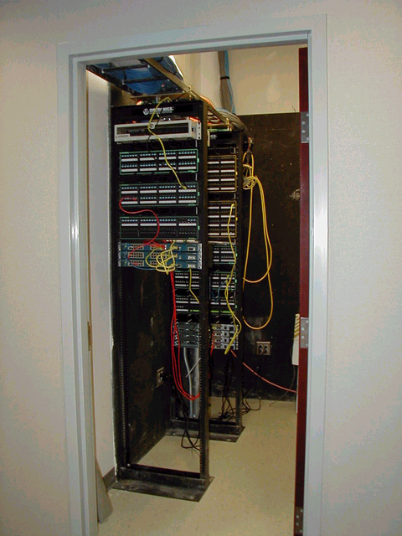
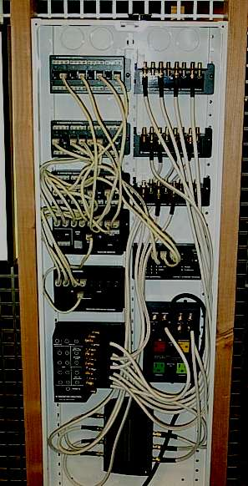
Dave Bremer - Otago Polytechnic
IT202001 Data Communication and Networking
Bachelor of Information Technology

Slide 6
Campus Backbone Cabling Subsystem
Runs from the Campus Distributor to the Building Distributor
May not be present if a single building
Includes the jumpers & patch cords in the campus distributor

Slide 7
Building Backbone Cabling Subsystem
Goes from the Building Distributor to the Floor Distributor
May not be present in a single-floored building
Includes the jumpers & patch cords in the building distributor

Slide 8
Horizontal Cabling Subsystem
Goes from the Floor Distributor to the Telecommunications Outlets at the work area
Includes
  jumpers & patches in the floor distributor
  An optional consolidation point
  Telecommunications Outlets (i.e. the sockets)
At least one FD should be provided for every
  Floor and
  1000m2 of floor area
If a floor is sparsely populated (eg a lobby or workshop) then it is permissible to serve this floor from an adjacent floor. This should be an exception.

Slide 9
Work Area Cabling Subsystem
All cables etc that are beyond the TO at the work area
Includes the fly-lead connecting the devices to the horizontal cabling.
It is not permanent and specific to the end equipment.
This cabling subsystem is outside AS/NZS3080

Slide 10
Design Goals
The objective is to provide a flexible installation that allows for growth.
A tree-like structure is recommended.
It is tempting to adopt other approaches that “seem like a good idea at the time”. This should be resisted as work areas frequently change. Designing for growth and flexibility is important

Slide 11
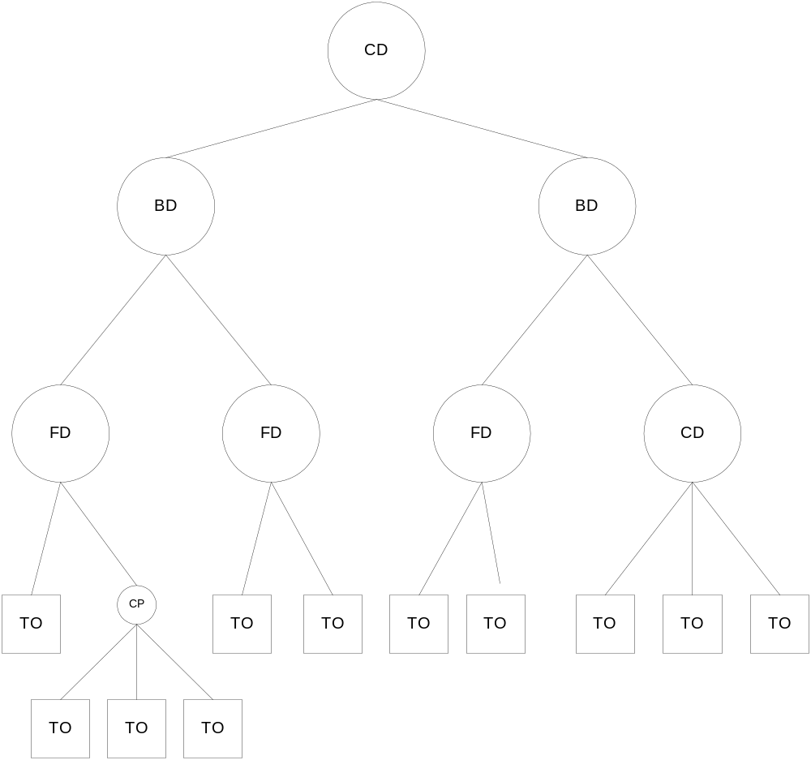
Hierarchical Structure of Generic Cabling
Dave Bremer - Otago Polytechnic
IT202001 Data Communication and Networking
Bachelor of Information Technology

Slide 12
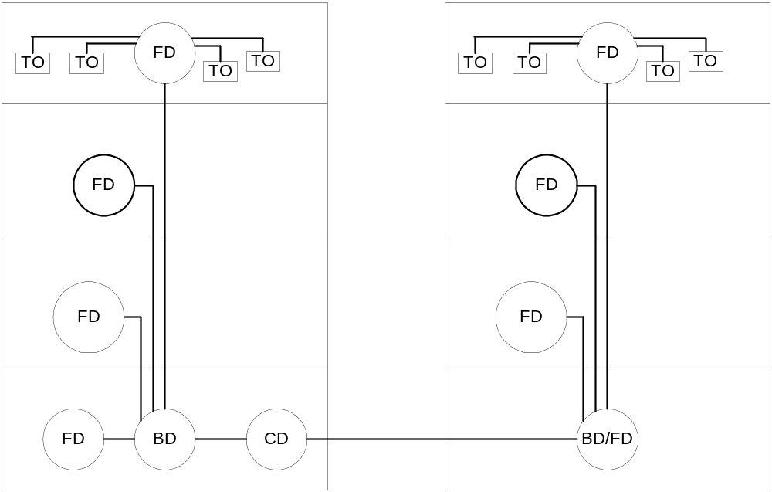
Combining Distribution Points
In second building the FD & BD are combined into one distribution point
Dave Bremer - Otago Polytechnic
IT202001 Data Communication and Networking
Bachelor of Information Technology

Slide 13
Maximum Lengths
You should locate the distribution rooms to ensure that the maximum cable lengths are not exceeded.
In general the maximum lengths are:
  Horizontal cabling: 100m
  Horizontal + Building Backbone + Campus Backbone: 2000m

Slide 14
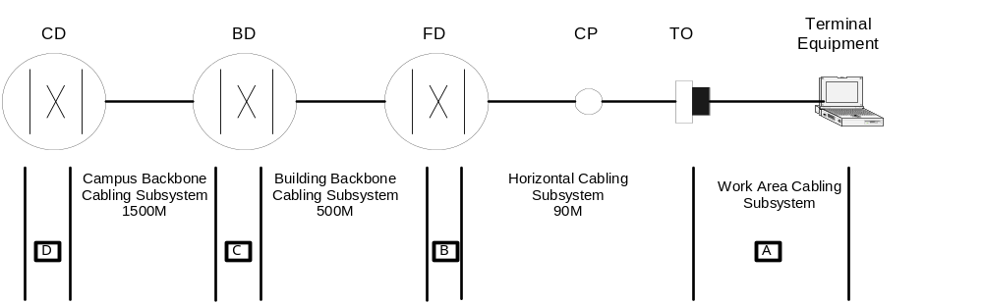
Normal Maximum Lengths
A+B < 10m
  Combined length of work area cable, equipment cable and patch or jumper cords in the horizontal subsystem must be less then 10m as overall horizontal cabling is max 100m (for cat 3-5 anyway)
C and D < 20m
  Max of 20m patch cords in BD & CD
Measurements will vary depending on actual cabling used
Dave Bremer - Otago Polytechnic
IT202001 Data Communication and Networking
Bachelor of Information Technology

Slide 15
Telecommunications Outlets (TO)
These are the sockets or plugs.
Computer networks usually use RJ45 sockets
The standard recommends a high density of outlets – stipulating that each work area should have two outlets, one of which should be terminated with a 4 pair data cable, the other should have either another 4 pair data cable or fibre.

Slide 16
Multi-user TO Assembly
The standard allows multiple work areas to be fed from a single grouping of TO’s – providing that this still leaves at least two TO’s for each work area
Other requirements for a MUTO are:
  Should be located in an open area so that each work-area can access it
  The MUTO should serve a maximum of 12 work areas
  The cables leading from the MUTO to the work area should be managed in a tidy fashion

Slide 17
Consolidation Point
The standard allows for a consolidation device such as a hub or a switch to connect multiple work area devices to the network
Only one consolidation point is allowed between the work area and the FD.
Must not serve more than 12 work areas
Must be accessible
Must be at least 15m from an FD

Slide 18
References & Further Reading
Required
  Forouzan Chap 1.4
  AS/NZS3080:2013. On close reserve in the library.
Recommended
  Key Steps in Designing and Installing a Structured Cabling System http://www.convergencecable.com/keys.htm
  The Tao of the IETF. RFC3160 http://www.ietf.org/tao.html Explains the IETF and how it works
  Relationship between the Internet Organizations http://www.ericsson.com/about/telecom/part-h/h-2-1.shtml
  Search for RFC’s http://www.rfc-editor.org/rfcsearch.html

